Slide 1

LapBoost Project Presentation
Team: Marvels
GitHub: https://github.com/danushvithiyarth/DIP392-marvels

Slide 2
Group members
Danush Vithiyarth Jaiganesh – 221ADB150 – Deployment process
Harikumaran Anandhan – 221ADB148 – Backend Development
Meganath Nandhakumar – 221ADB061 – Frontend Development and Report Management
Ahmed Salah Kamal Abdelgawad Elsayed – 250ADB021 – Communication with the customer and Requirements Management
Alexander Fernando Thundiparambil Judy Thadevouse – 221AMB023 – Database Management.

Slide 3
Project Overview and Motivation
An online marketplace platform for buying and selling devices and services.
Motivated by the need for a streamlined user-friendly system.
Aims to simplify transactions and improve accessibility.

Slide 4
Chosen SDLC Methodology
Agile methodology chosen for iterative development and flexibility.
Allows frequent feedback and continuous improvement.
Well-suited for evolving project requirements.

Slide 5
Requirements Gathering & Analysis
Conducted meetings with the customer to gather needs.
Analyzed competitor platforms and identified gaps.
Defined functional and non-functional requirements.

Slide 6
Software Requirements Specification
User authentication and authorization.
Device and service listing features.
Shopping cart and order management.
Secure payment and session management.

Slide 7
System and Software Design
Node.js backend with Express.js framework.
SQLite database for data storage.
Frontend implemented with HTML, CSS, and JavaScript.
Session management and password encryption for security.

Slide 8
Implementation Phase
Developed sqlite database for user and product management.
Designed frontend pages for marketplace and user interaction.
Integrated SQLite database with CRUD operations.
Implemented authentication with bcrypt hashing.

Slide 9
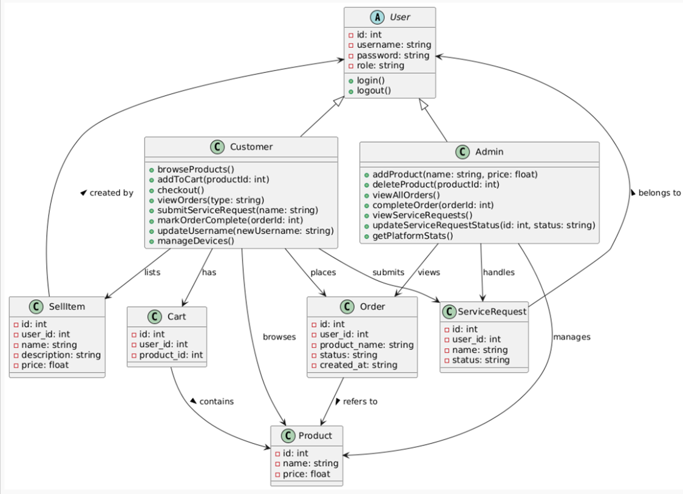

Slide 10
Testing Strategy
Manual testing of user workflows and API endpoints.
Validation of input data and session management.
Cross-browser compatibility testing for frontend.
Bug tracking and iterative fixes.

Slide 11
Test Results and Validation
All critical user flows tested successfully.
Handled edge cases for login and data input.
Session persistence verified across multiple requests.
User feedback incorporated for UI improvements.

Slide 12
Process Challenges and Lessons Learned
Managing asynchronous database calls effectively.
Balancing security with usability in authentication.
Learning to structure Node.js applications cleanly.
Importance of detailed requirement analysis.

Slide 13
Demo Overview
User registration and login flow.
Browsing and searching device listings.
Adding items to cart and placing orders.
Sql database for saving and retrieving data

Slide 14
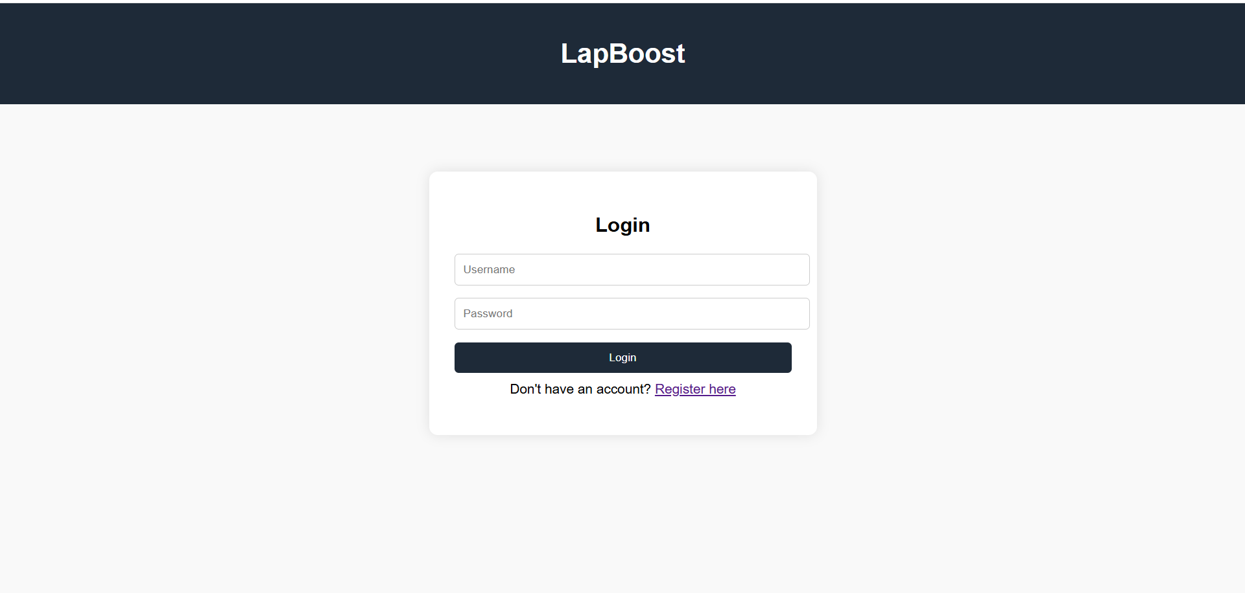

Slide 15
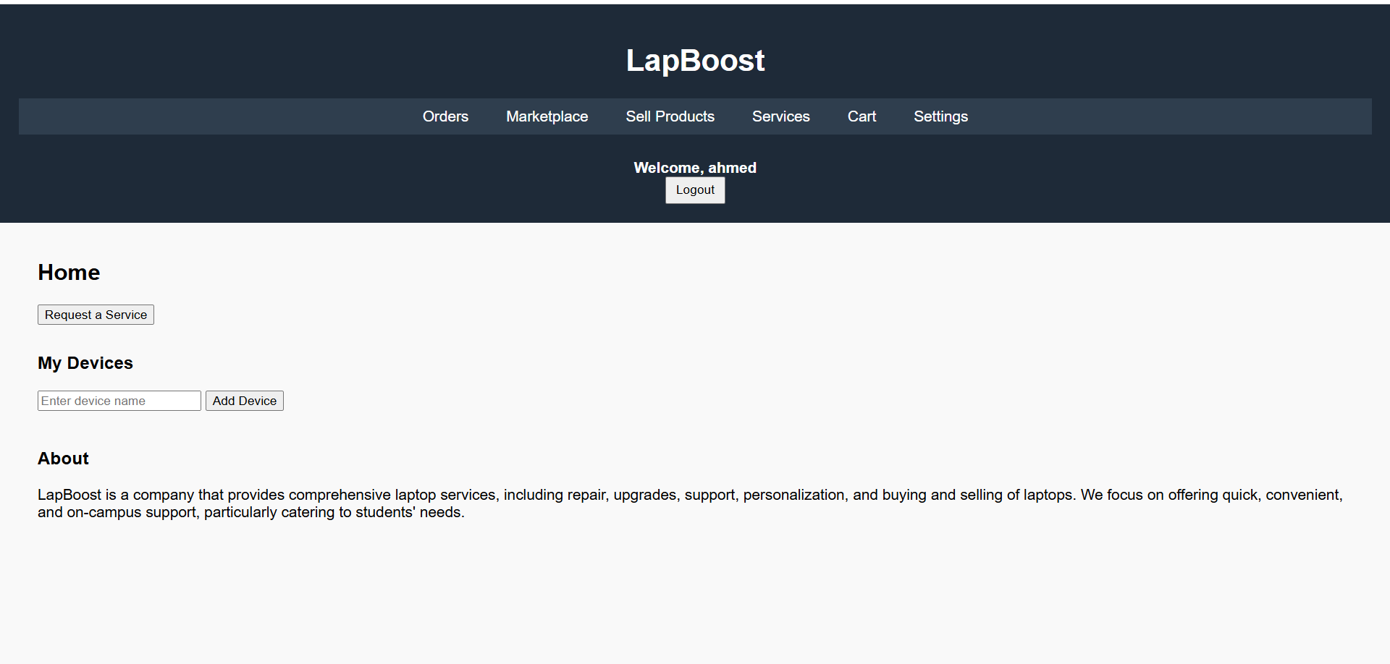

Slide 16
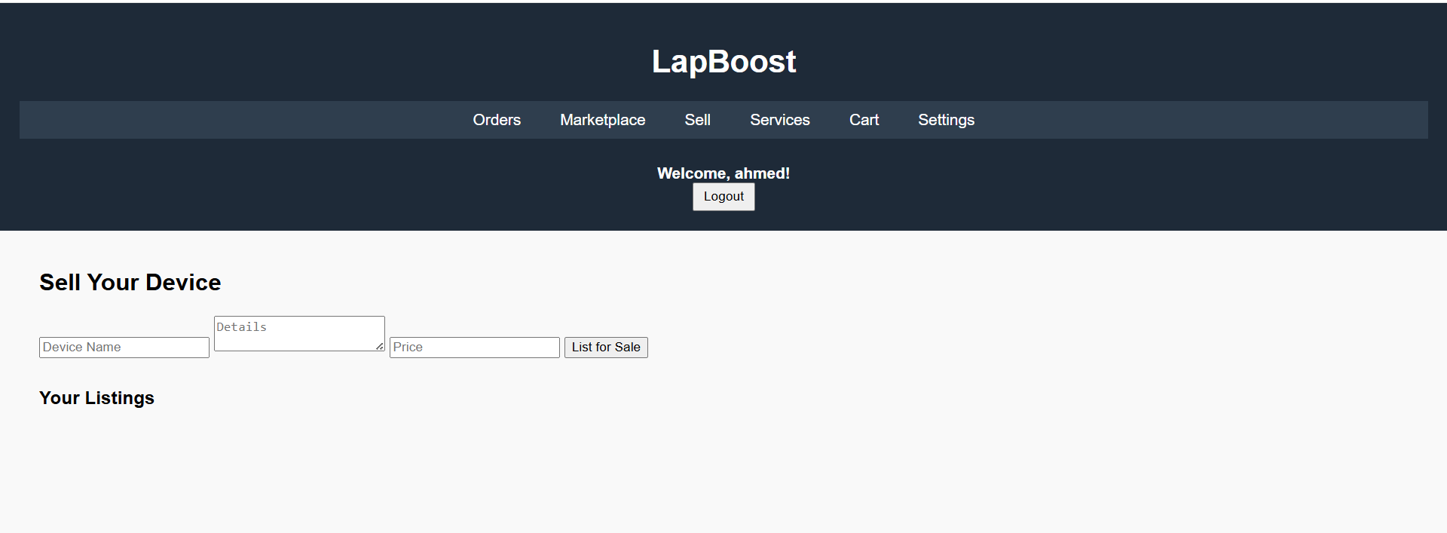

Slide 17
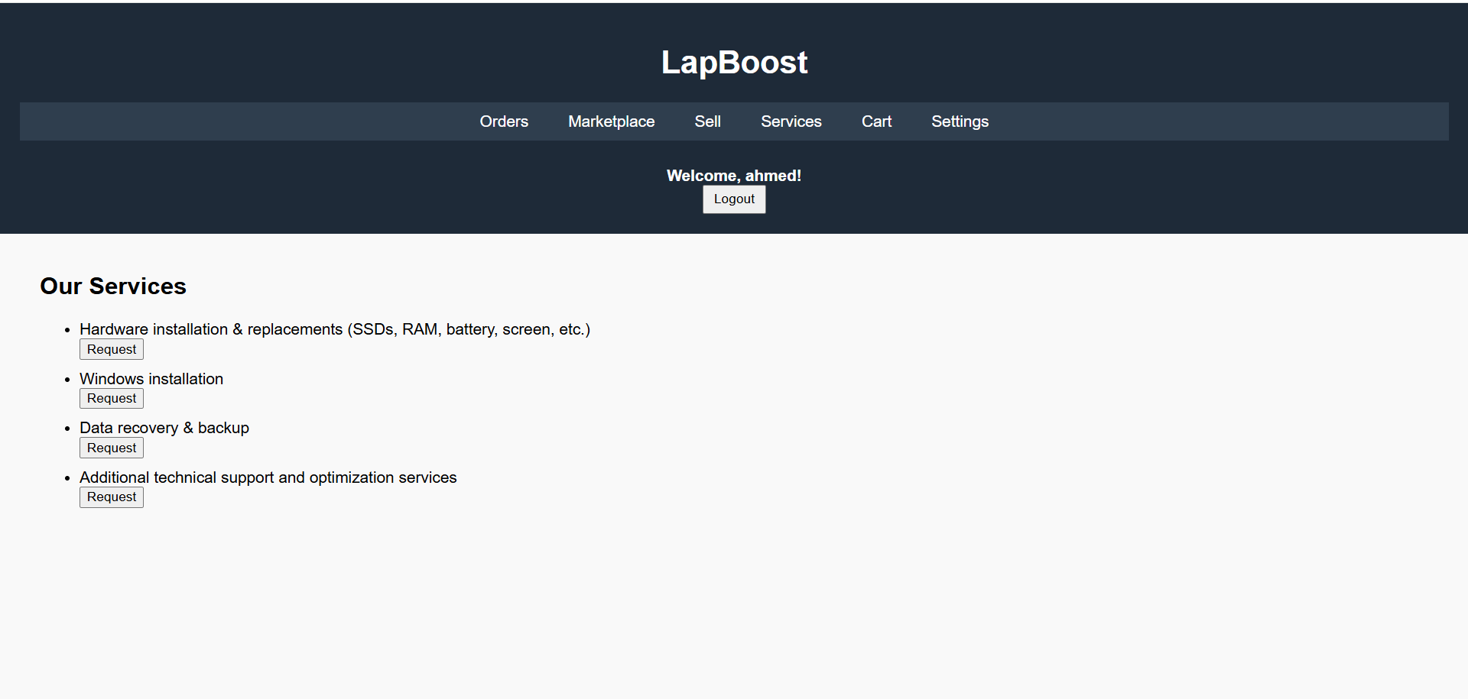

Slide 18
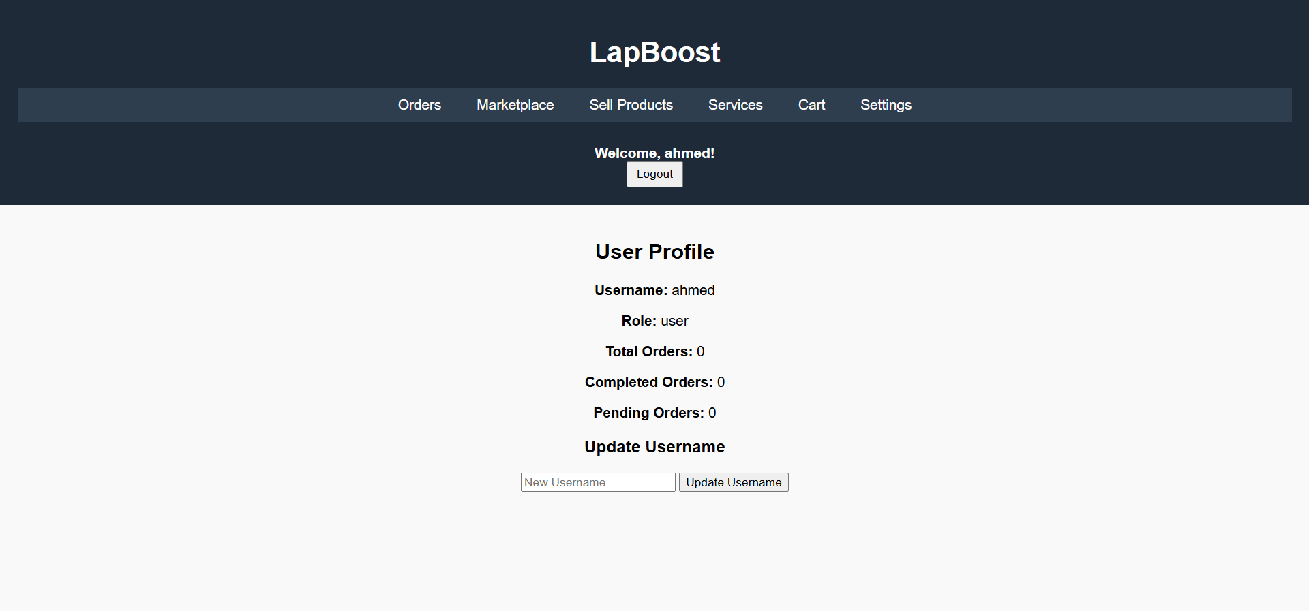

Slide 19
Conclusion and Future Work
Project successfully met key requirements.
Future enhancements: payment gateway integration, real-time chat.
Improve UI/UX.
Create a mobile application.

Slide 20
Q&A / Feedback
Thank you for your attention!
We welcome your questions and suggestions.

